Slide 2


Projection methods in chemistry
M. Daszykowski, B. Walczak, D.L. Massart*
Chemometrics and Intelligent Laboratory Systems 65 (2003) 97–112
By: Atefe Malek.khatabi
Autumn 2011

Slide 3
Visualization of a data set structure is one of the most challenging goals in data mining.
In this paper, a survey of different projection techniques, linear and nonlinear, is given.
Compression is possible due to the two reasons:
visualization and interpretation of high-dimensional data set structure carry out with clustering of data or data reduction.
often many variables are highly correlated
their variance is smaller than the measurement noise.

Slide 4
Linear projection methods:
principal component analysis PCA
Pursuit projection PP
This type of analysis (PCA) has been first proposed by Pearson and fully developed by Hoteling.
PCA allows projection of multidimensional data onto few orthogonal features, called principal components (PCs), constructed as linear combination of original variables to maximize description of the data variance.
The dimensionality reduction techniques do not always reveal clustering tendency of the data.
The intent pursuit projection (PP) is to reveal the sharpest low-dimensional
projection to find clusters.

Slide 5
PP was originally introduced by Roy and Kruskal.
PP is an unsupervised technique that searches interesting low dimensional linear projections of a high-dimensional data by optimizing a certain objective function called projection index (PI).
The goal of data mining (i.e. revealing data clustering tendency) should be translated into a numerical index, being a functional of the projected data distribution.
This function should change continuously with the parameters defining the projection and have a large value when the projected distribution is defined to be interesting and small otherwise.
In this paper, the described algorithm is used with two different projection indices

Slide 6


Entropy: Huber and Jones and Sibson suggested PI based on the Shannon entropy:
where f(x) is a density estimate of the projected data.
This index is uniquely minimized by the standard normal density. The required density estimate, f(x) can be calculated as a sum of m individual density functions (kernels), generated at any position x by
each projected object:

Slide 7
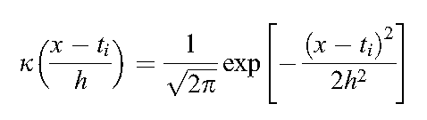

where h is the so-called smoothing parameter (band width), k is a kernel function, t1, t2,. . ., tm denote coordinates of the projected objects.
where r parameter is estimated from the data, usually by sample standard deviation, and m is the number of data objects.

Slide 8

Yenyukov index Q.
According to the nearest neighbour approach proposed by Yenyukov , the clustering tendency of data can be judged based on the ratio of the mean of all inter-objects distances, D, and the average nearest neighbour distance, d, i.e.:
For clustered data, Q has a large value, whereas for less clustered ones Q is small.

Slide 9
Nonlinear projection methods:
Kohonen self organization map SOM
Generative Topographic Maps GTM
Sammon projection
Auto-associative feed-forward networks
Kohonen self-organizing maps (SOM)
A Kohonen neural network is an iterative technique used to map multivariate data. The network is able to learn and display the topology of the data.
When each sample is represented by n measurements (n>3), by a two or three-dimensional representation of the measurement space we can to visualize the relative position of the data points in n-space.

Slide 10
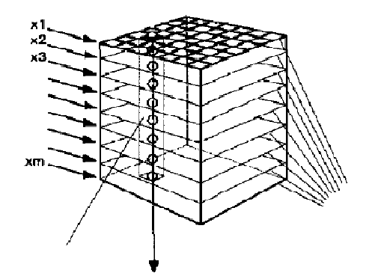
To compare with PCA , SOM didn’t need to data preprocessing.
A Kohonen neural network maps multivariate data onto a layer of neurons arranged in a two dimensional grid.
Each neuron in the grid has a weight associated with it, which is a vector of the same dimension as the pattern vectors comprising the data set.
Each input
Each
neuron
m
m weight level
m
Position of neuron by excited Xs

Slide 11


the number of neurons used should be between 33% and 50% of the number of input vector in the training set. The
components of each weight vector are assigned random numbers.
where wi(t + 1) is the ith weight vector for the next iteration, wi(t) is the ith weight vector for the current iteration, is the learning rate function, is the neighborhood function, and xi is the sample vector currently passed to the network.
The learning rate is chosen by the user as a positive real number less than 1.
The decrease of the neighborhood can be scaled to be linear
with time, thereby reducing the number of neurons around the winner being adjusted during each epoch.

Slide 12
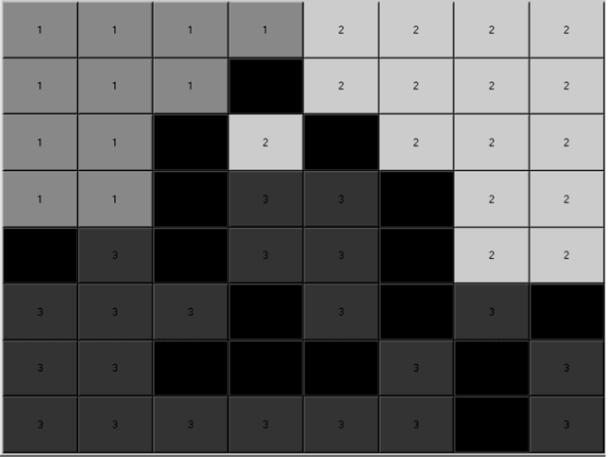
The control parameters include:
the number of epochs (iterations),
grid topology and size,
the neighborhood function,
the neighborhood adjustment factor,
the learning rate function
Top map

Slide 13
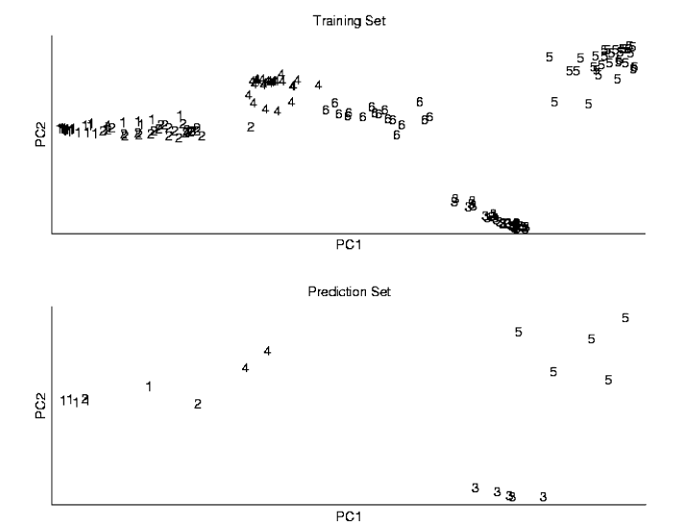
218
169 training set
188 Raman spectra of six common household plastics
188
19 prediction set

Slide 14
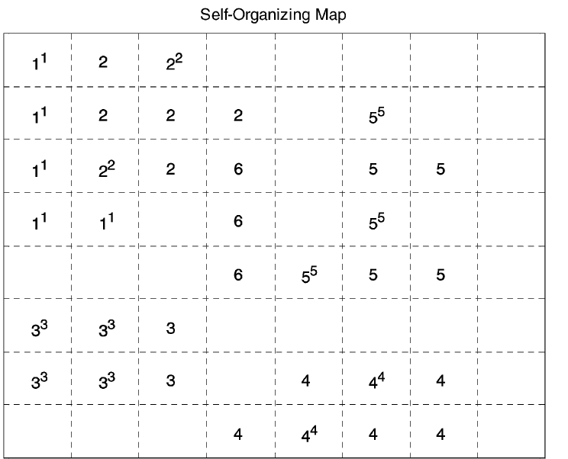

Slide 15
Generative Topographic Maps (GTM):
Generative Topographic Mapping (GTM), introduced by Bishop et al.
The aim of the GTM procedure is to model the distribution of data in an n-dimensional space x=[x1, x2,. . ., xn] in terms of a smaller number of latent variables, u=[u1, u2,. . ., uL].

Slide 16
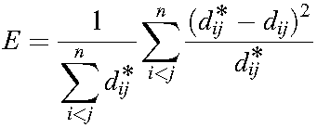
Sammon projection:
Sammon’s algorithm maps the original space onto a low-dimensional projection space in such a way that the distances among the objects in the original space are being preserved as well as possible.
where dij* is the distance between two objects i and j in the original space and dij defines the distance between those objects in the reduced space.
The computational time is much longer than for SOM and for new samples it is not possible to compute their coordinates in the latent space where as SOM allow that.

Slide 17
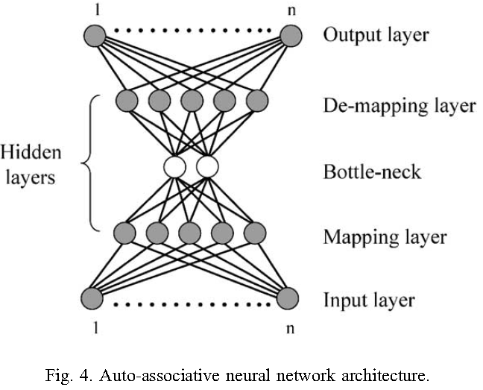
Auto-associative feed-forward networks (BNN):
For the first time auto-associative mapping was used by Ackley et al.

Slide 18
Feed-forward network is usually used in supervised settings.
This type of neural network is also known as a bottleneck neural network (BNN), and in the literature is often referred as nonlinear PCA.
Net training is equivalent with weights’ adjustment.
Weights, initialized randomly, are adjusted in each iteration to minimize the sum of squared residuals between the desired and observed output.
Once the net is trained, the outputs of the nonlinear nodes in
the second hidden layer serve as data coordinates in reduced data space.

Slide 19
Results and discussion:
Data sets:
Data set 1 contains 536 NIR spectra of three creams with three different concentrations of an active drug.
Data set 2 contains 83 NIR spectra collected in the spectral range of 1330–2352 nm for four different quality classes of polymer products.
Data set 3 contains 159 variables and 576 objects.
Objects are the products of Maillard reaction of mixtures of one sugar and one or two amino acids at constant pH = 3.

Slide 20
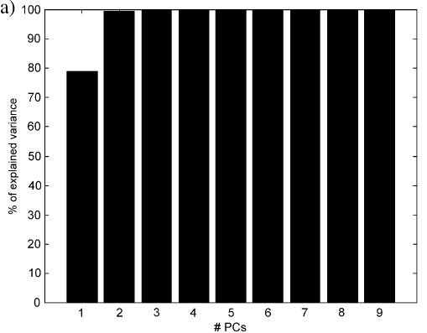
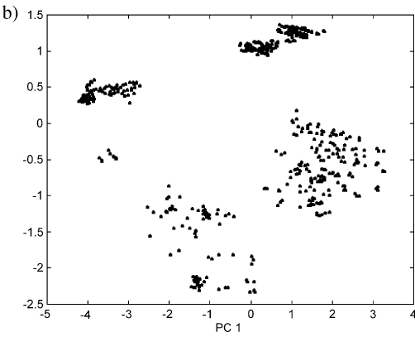
Results and discussion:
data set 1 containing 701 variables can very efficiently be compressed by PCA to two significant PCs

Slide 21
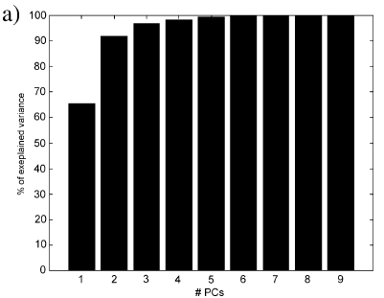
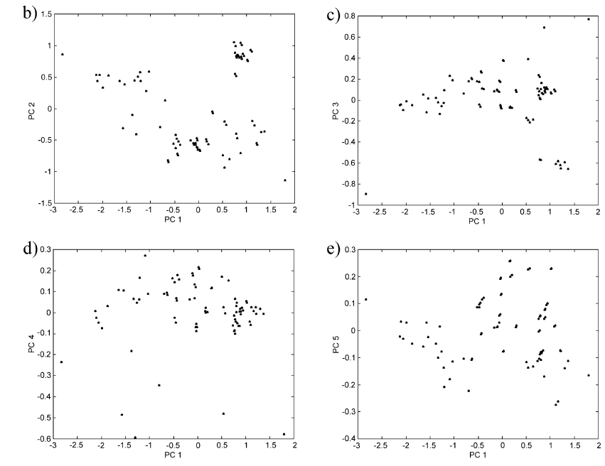
Data set2

Slide 22
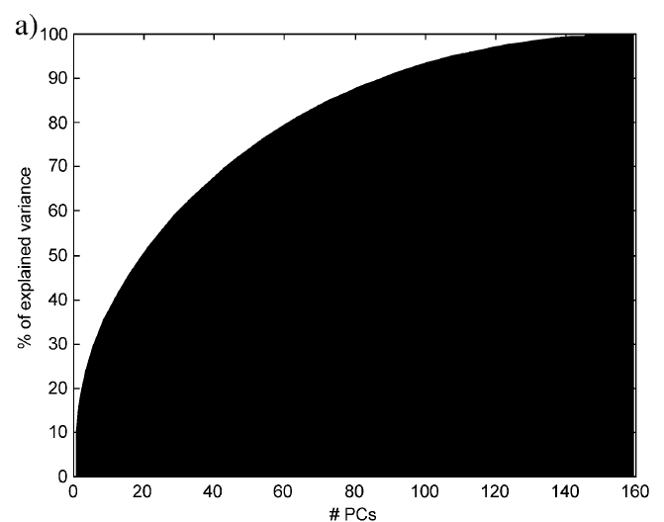
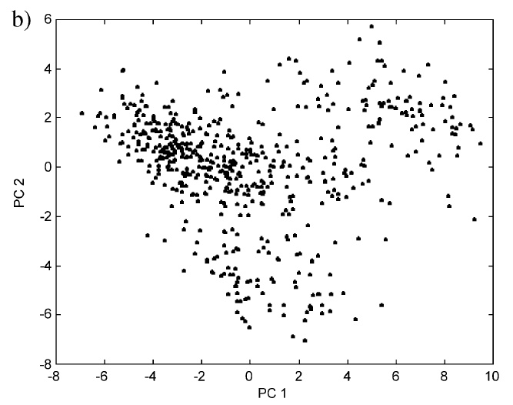
Data set3:

Slide 23
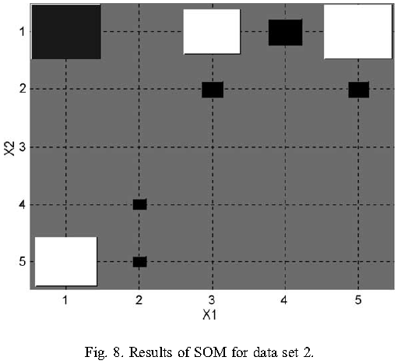
the size and the color intensity of the node are proportional to the number of objects therein. The biggest node (1,1), i.e. contains 21 objects and the smallest nodes, (4,2) and (5,2) contain only one object each

Slide 24
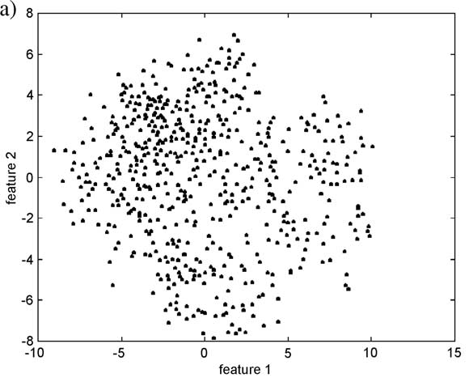
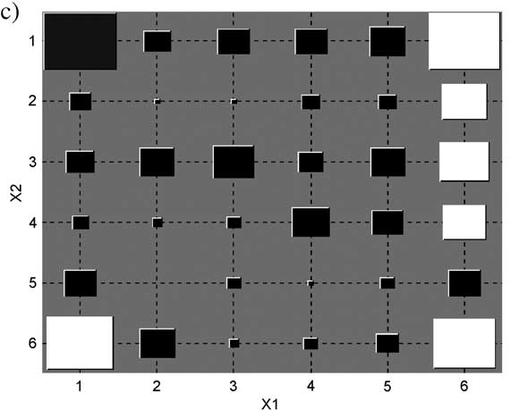
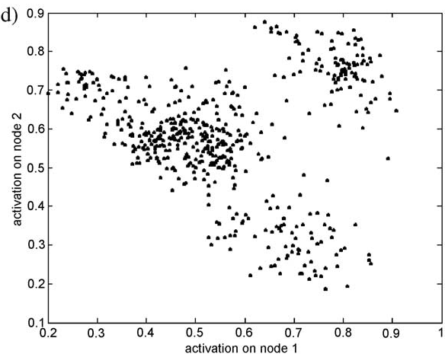
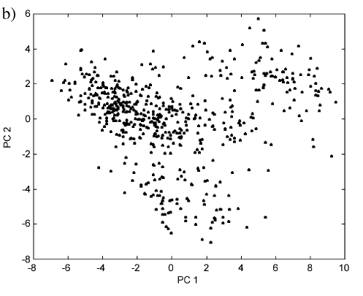
sammon
SOM
PCA
BNN

Slide 25
In case of Sammon projection, no real clustering tendency is observed by the Kohonen map the biggest nodes are in the corners of the map.
Based on the content of Fig. 10 only, it is difficult to draw more conclusions.
The results of BNN with two nodes in the ‘‘bottleneck’’ and seven nodes in mapping and de-mapping layer, respectively, reveal two classes, better separated than in SOM

Slide 26
