Slide 1


Slide 2
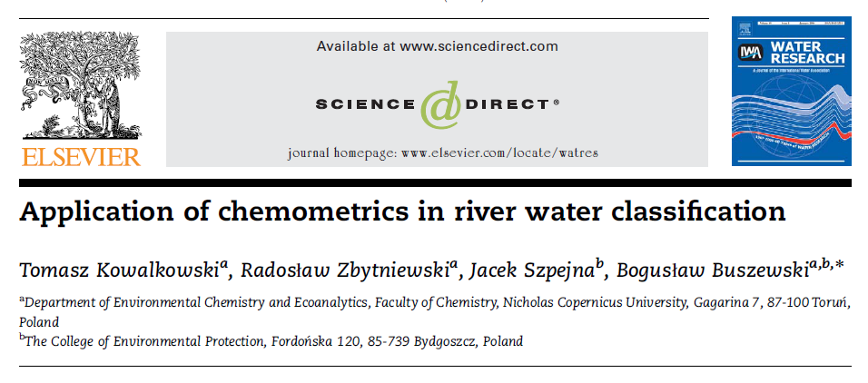

Slide 3
A B S T R A C T
The study presents the application of selected chemometric
techniques to the pollution monitoring dataset, namely, cluster analysis, principal
component analysis, discriminant analysis and factor analysis.
Chemometric analysis
confirmed the classification of water purity of the Brda river made by the Inspection of
Environmental Protection but the results showed more differentiation between monitored
locations.

Slide 4
introduction
The classification of the river water quality is generally based on the comparison of measured values of a particular pollution parameter’s concentration with the limit values as defined in the adequate legal instrument .
The quality standards for rivers are defined on the basis of the water use criteria.
Moreover, 90% of the values must meet the
appropriate level to attribute the water to one of the five classes.

Slide 5
There are two most
common methods of unsupervised pattern recognition,
Namely , cluster analysis (CA) and principal component
analysis (PCA) with factor analysis (FA).
Usually, CA is carried out to reveal specific links between
Sampling points, while PCA and multiple regression analyses are used to identify the ecological aspects of pollutants on environmental systems.
CA were used for site similarity analysis, whereas for the identification of sources of pollution, PCA followed by absolute principal Component scores were applied.

Slide 6
Brda river and its basin
Brda is one of the western tributaries of the Vistula river. It flows through the Kaszuby and Kujawy regions in the
Northern part of Poland.
The total length of the Brda river is 238 km.
The Brda catchment covers an area of 4693km2.
Agriculture, farming and aquaculture are quite
intensive, with many cattle , pig , poultry , sheep , and fish farms. This is likely to cause water quality problems with respect to organic waste and nutrients.
Industries are mainly found in and around
Bydgoszcz, varying from food production , metals and
ceramics to chemical industries (pharmaceutical, organic–
chemical, etc.).

Slide 7
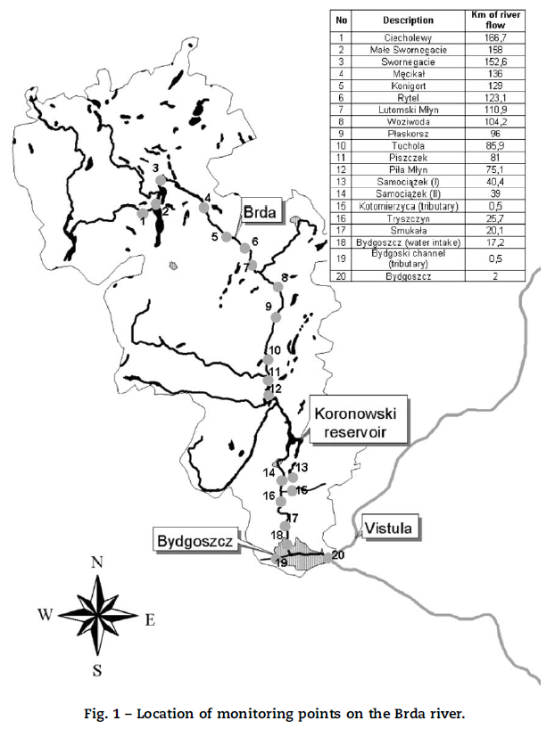

Slide 8
The dataset and statistical procedures
(a) Dataset:
The dataset covers the period from January 1994 to December 2002 and contains the values of selected pollution indicators for 20 monitoring locations.
Locations of the monitoring points and selected pollution indicators are presented on Fig. 1 and Table 1.

Slide 9
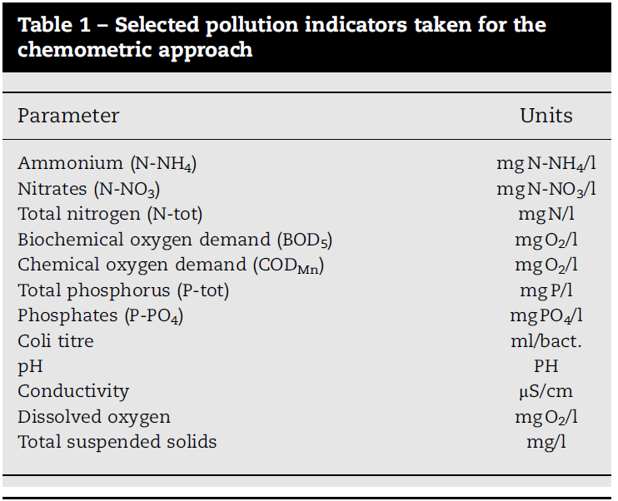

Slide 10


(b) Cluster analysis: CA is an exploratory data analysis tool
for solving classification problems. Its objective is to sort
cases (monitoring pints) into groups, or clusters.
The descriptor variables (pollution
indicators) were block standardized by range (autoscaling) to
avoid any effects of scale of units on the distance measurements
by applying the equation:
The similarities–dissimilarities were quantified through
Euclidean distance measurements; the distance between
monitoring point locations, i and j, is given as
Normalized Euclidean distances and the Ward’s method were used to obtain
dendrograms

Slide 11
(c) Principal component analysis and factor analysis:
On the basis of the dataset, new orthogonal variables
(factors) as the linear combination of original parameters are
calculated. Owing to this, all information about the objects
gathered in the original multidimensional dataset can be
performed in the reduced space and explained by a reduced
set of calculated factors called principal components (PCs).
Identified PCs (e.g. by eigenvalue-one criterion) account for
the maximum explainable variance of all original property
parameters in a descending order.

Slide 12
Factoe analysis:
FA is a useful tool for extracting latent information, such as not directly observable relationships between variables .
The original data matrix is decomposed into the
product of a matrix of factor loadings and a matrix of factor
scores plus a residual matrix.
In general, by applying the
eigenvalue-one criterion, the number of extracted factors
is less than the number of measured features.
So the dimensionality of the original data space can be decreased by means of FA.

Slide 13
(d) Discriminant analysis:
The principle of DA consists of the
separation of a priori given classes of objects. The variance–covariance between the classes is maximized and the variance–covariance within the classes is minimized under simultaneous consideration of all analyzed features.

Slide 14
Results and discussion
On the basis of scree-plot for the PCA, up to 99% of the
original dataset variability is now gathered in the
first six new variables (components). Owing to this, all
information about pollution in 20 monitoring locations
gathered in the original 12 variables can be performed in
the reduced space and explained by a set of calculated
variables (PCs).
According to the eigenvalue-one criterion, only the PCs with
eigenvalues greater than one are considered as important
ones. This criterion is based on the fact that the average
eigenvalues of the autoscaled data is just one. The scree-plot
shows that although the eigenvalues of PC3 and PC4 are
slightly below one, the explained variances are quite high
(7.57% and 7.09%) (Fig. 3).

Slide 15
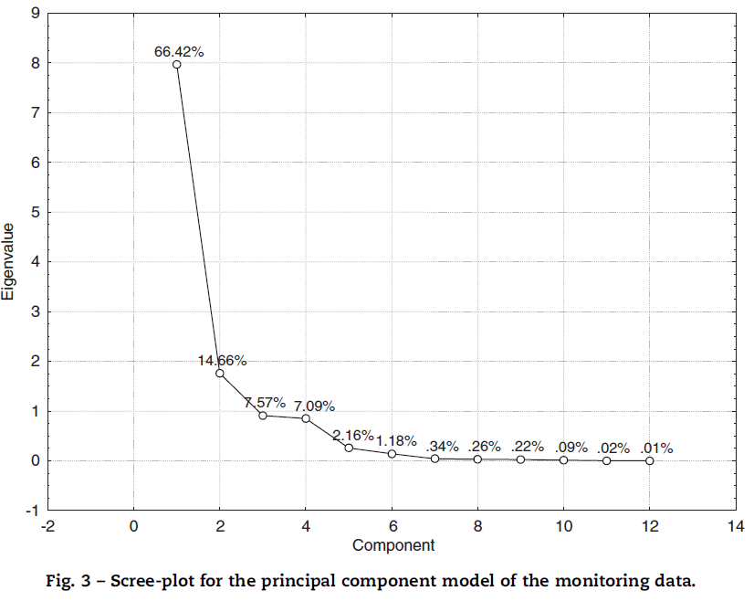

Slide 16
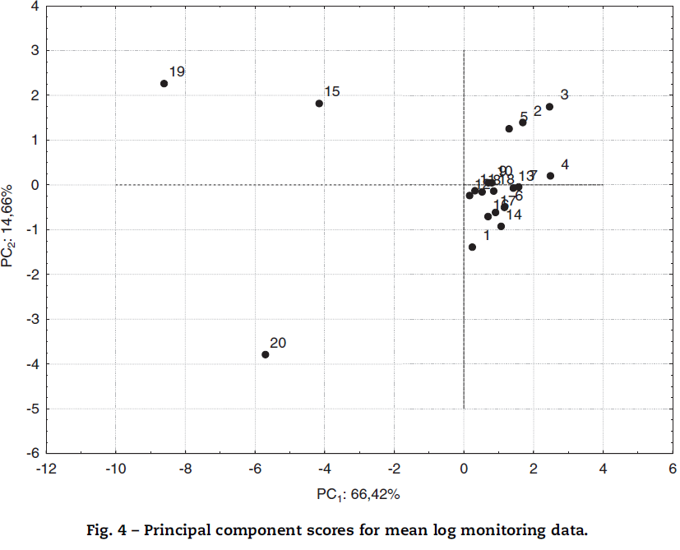

Slide 17
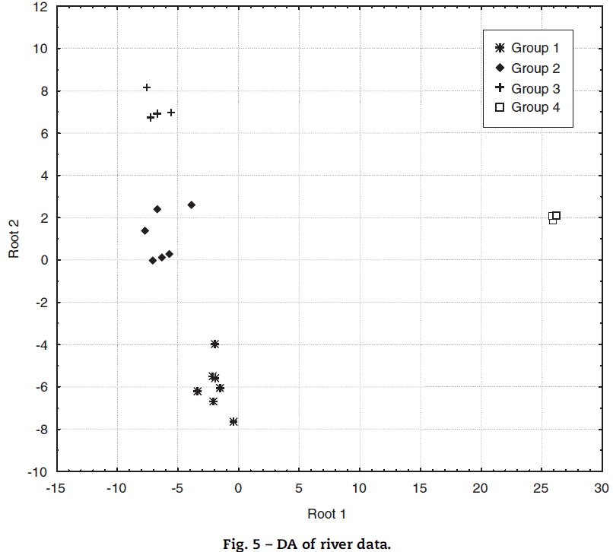

Slide 18
The correlation matrix, presented in the Table 3,
also confirms the high interdependence between particular
variables.
The high correlations obtained between some variables can easily be rationalized for example, between N-NO3 and N-tot, or P-tot and P-PO4.
But there are also some less obvious correlations namely
between N-NH4 and P-PO4.
The redundancy of information suggests applying the FA in
order to reduce the dimensionality of dataset as it was done
in PCA. On the basis of the scree-plot (Fig. 3) the maximum information is gathered in the first four factors (95%).
However only first two are significant and exceed eigenvalue
of 1.

Slide 19
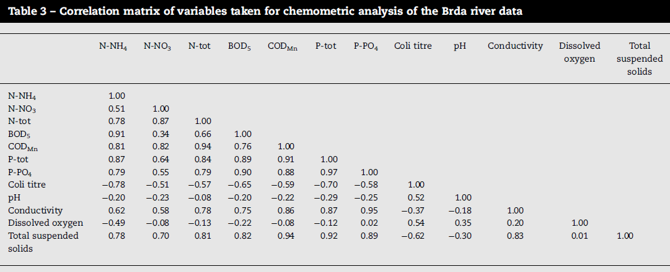

Slide 20
By the representation of the factor scores versus monitoring location the pollution sources in the river system may be identified.
In Fig. 6 high scores correspond to high influence of the
factor on the sampling site. Factors 1 and 2 are crucial for the condition of the monitoring locations 19 and 20 which are described as highly polluted by municipal discharge Factor 3 identifies the point 15 that is located on
the estuary of the Brda’s tributary Kotomierzyca. The
Kotomierzyca river is highly influenced by agriculture On the contrary the influence of factor 4 (pH) on
the grouping pattern may be described as similarly low to
points 2, 3, 4, 5 (cluster II, see Fig. 1) and 15.

Slide 21
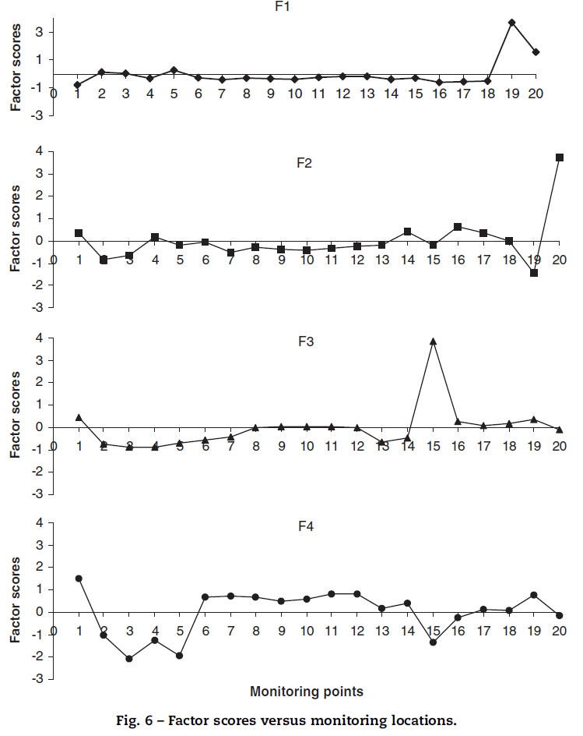

Slide 22
Conclusions
Brda is an important river in the whole river system in Poland.
Its basin links two major river systems Odra and Vistula
(through the Bydgoski channel).
However, some differences between the monitoring locations are not recorded by the classification model used by the Inspection during the years By applying FA it was possible to identify main pollution sources in heavily polluted locations: 15, 19 and 20. It was found that water in the monitoring point no. 15 is mainly polluted by agriculture (high loads of N-tot, N-NO3), while the points 19 and 20, localized within the borders of the Bydgoszcz city, are influenced by the loads of the municipal pollution sources.

Slide 23

Thanks for your kind attention

