Slide 1
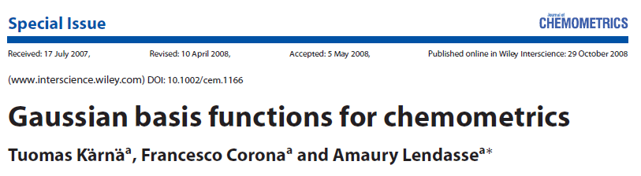
«هو اللطیف»
By:
Atefe
Malek.khatabi
Spring 90

Slide 2
abstract
In this paper, we propose a method that is based on functional approximation using Gaussian basis functions. The basis functions are optimised to accurately fit the spectral data using nonlinear Gauss–Newton algorithm. The fitting weights are then used as training data to build a least-squares support vector machine (LS-SVM) model. To utilise the reduced data dimension, relevant variables are further selected using forward–backward (FB) selection. The methodology is experimented with three datasets originating from the food industry.The results show that the proposed method can be used for dimensionality reduction without loss of precision.

Slide 3
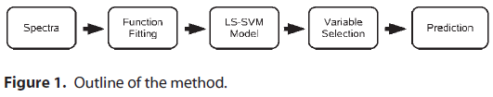
introduction
For comparison partial least squares (PLS) and principal component regression (PCR) models are also experimented.

Slide 4
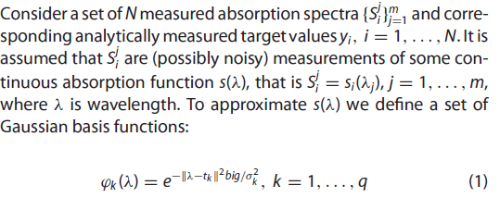
GAUSSIAN BASIS

Slide 5
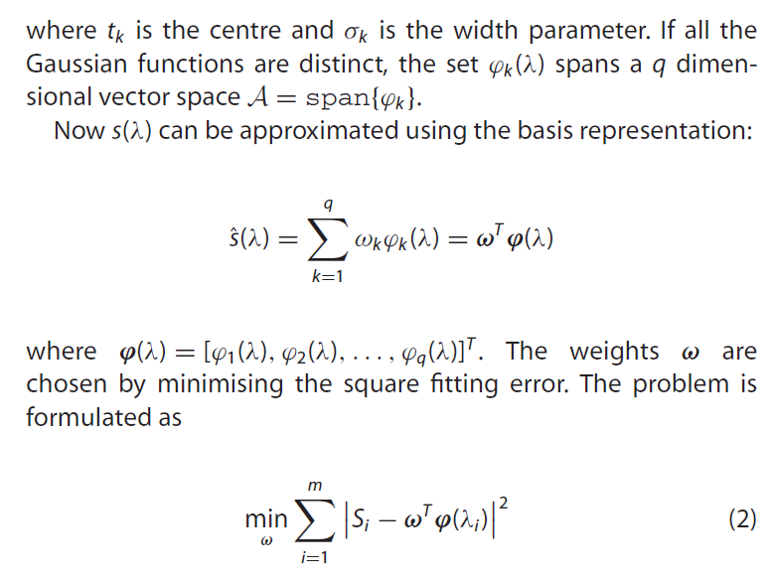

Slide 6
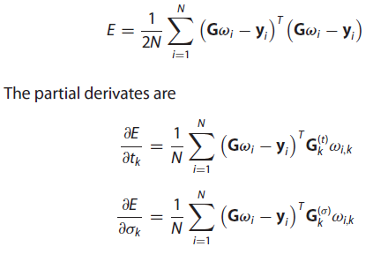
Optimisation of locations and widths
Since the basis functions are differentiable, the locations and
widths can be optimised for a better fit. The average fitting error
of all functions is obtained by averaging Equation (2) over all of
the sample inputs i = 1, . . . , N. Using the matrix notation given
above, it can be formulated as

Slide 7
FORWARD–BACKWARD VARIABLE
SELECTION
The most simple variable selection method is exhaustive
search, that is trying out all the possible variable combinations.
However, exhaustive search quickly becomes impossible as number of variables grow. FB selection is a faster algorithm but there is no guarantee that the optimal set of variables is found.
In FB algorithm, each variable can be in two states: ‘on’, meaning that it belongs to the set of selected variables or ‘off’ meaning that it is discarded. Given a certain initial state vector (states of all variables), the algorithm proceeds by flipping the state of each variable at a time and by computing the corresponding error measure.

Slide 8
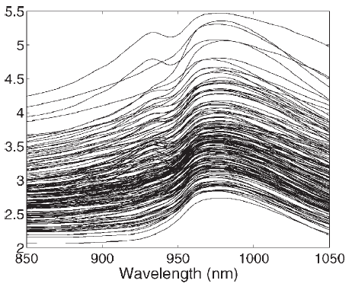
Datasets
1)Tacator: range of fat content
0.9_49.1%
100
learning CL
172
Training set of tacator
43
Test CT
256
215
Learning CL
2)Win: Range of alcohol content
7.48_18.5%
94
34
Test CT
124

Slide 9
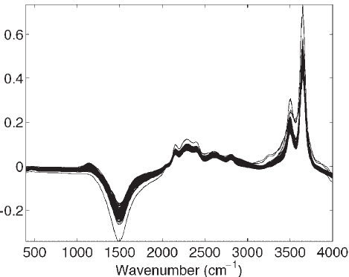
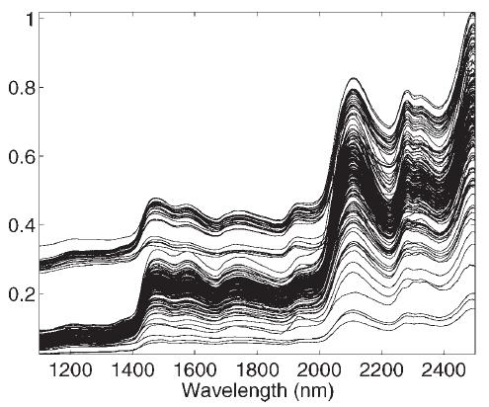
3)Orange juice:range of
Saccharose content:
0_78.8
Training set of juice
Training set of wine
700
Learning CL
146
67
Test CT
213

Slide 10
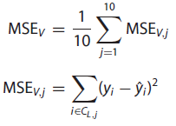

Error measures
In the training phase, 10-fold cross-validation is used. Denoting the 10 subsets of CL as CL,1, CL,2, . . . , CL,10, the cross-validation MSE is defined as
where ˆyi represents the estimated concentration and each MSEV,j
is associated to a model that has been trained with the set CL \ CL,j
The generalisation performance is estimated by simulating
the prediction model on the test set CT .
However, since the test sets are rather small, the MSET is not very reliable error measure and thus the validation errors must also be taken into consideration when interpreting the results.

Slide 11
Selecting number of basis functions
The maximum number of functions was 25, 36 and 35 for Tecator, wine and juice datasets, respectively.
However, it should be noted that the Gaussian basis functions provide a more accurate fit that B-splines of the same dimension.
The number of latent variables (in PLS) and number of pc (in PCA) were selected using the same 10-fold cross-validation.
The number of basis functions was also selected using the same criterion. Furthermore, to illustrate the effect of the Gaussian fitting, all the three models, PCA, PLS and LS-SVM, were trained with the raw spectral data as well.

Slide 12
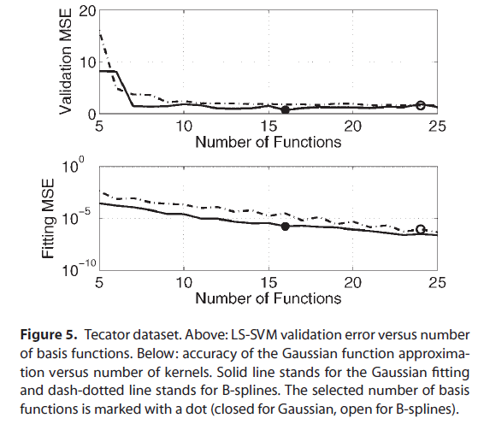
Note: learning sets were randomly permutated. The same permutation was used in all tests to obtain fully comparable results

Slide 13
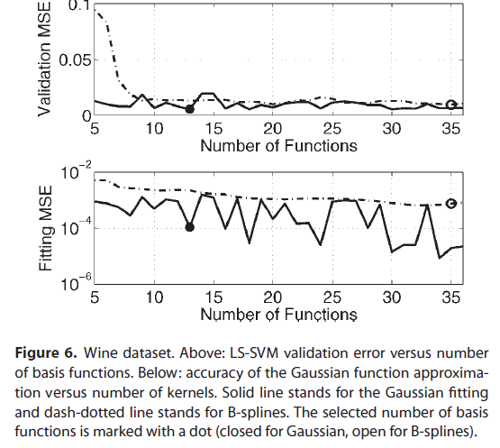

Slide 14
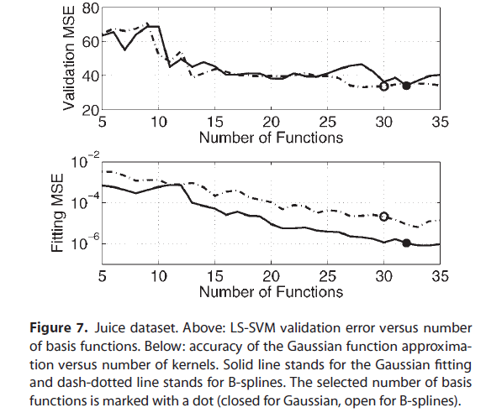

Slide 15
FB variable selection
In the case of the Tecator dataset, the number of Gaussian basis
functions was 16, out of which 10were selected by the FB process.
Using the B-spline basis, 24 functions were chosen, out of which
11 were selected. For the Wine dataset, Gaussian fitting resulted
in 13 variables out of which 8 were selected while B-spline fitting
resulted in 35 variables out of which 15 were selected. The results
obtained with the juice dataset are similar: Gaussian fitting
resulted in 32 variables out of which 9 were selected and B-spline
fitting resulted in 30 variables out of which 10were selected. Thus
in all the cases spectra were compressed remarkably, resulting in
only 8–15 significant variables

Slide 16
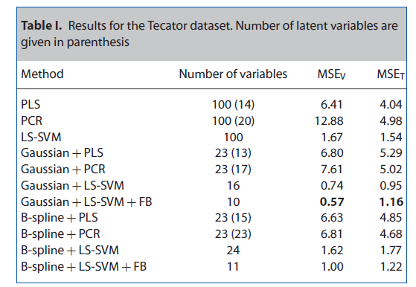
RESULTS
The prediction errors obtained with the three datasets are presented in Tables I–III.

Slide 17
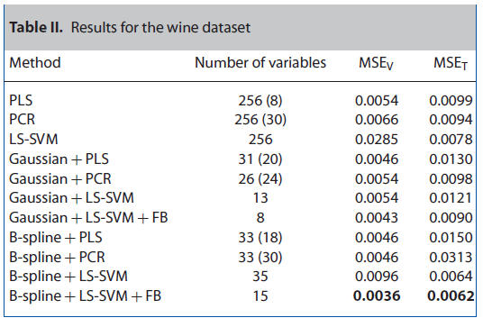

Slide 18
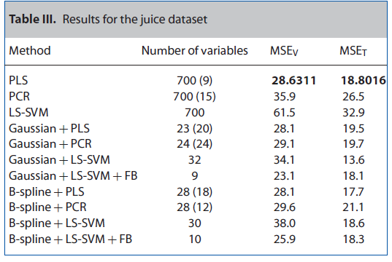

Slide 19
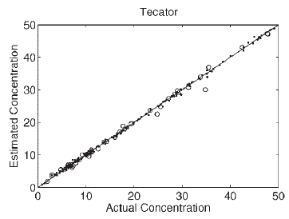
Tacator
Using the Gaussian fitting improves the performance even more. However, combining FB variable selection to the Gaussian+LS-SVM model decreases the validation error but increases the test error.Since both the learning set and the test set are small, it is not clear
whether this is due to over fitting: the validation error is an average of 10 separate estimates, so theoretically it should be more accurate than the test error. On the other hand, however, the validation error has been minimised during the training process, so itis not independent and thus not as reliable as the test error.

Slide 20
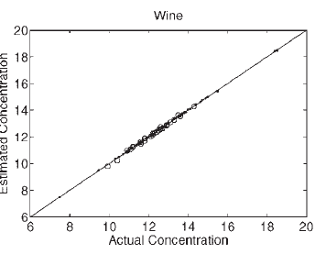
Wine
all the models, including plain PLS and PCR, give good results which suggests that the problem is highly
Linear.Despite the linearity of the problem,combining the function fitting with LS-SVM model yields good results. Again,considering both MSEV and MSET one can conclude that the B-spline+LSSVM+FB is the best model. However, the Gaussian+LS-SVM +FB results in significantly smaller number of variables while the performance remain satisfactory.

Slide 21
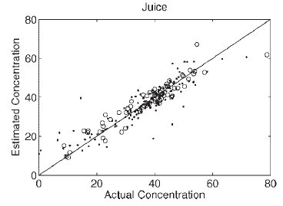
juice
Among the plain regression models, plain PLS performs the best. Gaussian+LS-SVM+FB and B-spline+LS-SVM+FB give slightly better results, but considering the size of the dataset, the difference can hardly be considered as significant.
Therefore, due to the simplicity of PLS, one can conclude that plain PLS is the best model.

Slide 22
conclusion
Gaussian fitting combined with LS-SVM model performed best on the Tecator dataset and it was observed that the Gaussian fitting tends to compress the data more than the B-splines.
However,B-splines gave better results in the wine dataset. Furthermore,the results obtained with the juice dataset suggest that in some, rather difficult cases, the function fitting cannot improve the prediction performance.
Therefore, the choice of method depends on the dataset and the goal of the analysis.
the importance of learning set and test set size becomes very clear. Therefore, in future the methodology should be tested on various large datasets in order to be able to obtain more reliable performance measures.

Slide 23
Thanks

