Slide 1

Real-time multidimensional NMR follows
RNA folding with second resolution
PNAS, 2010, vol. 107, no. 20, 9192–9197
Zeinab Mokhtari
1-Dec-2010

Slide 2
Riboswitch
Genetic control elements found in untranslated regions of prokaryotic and, less often, eukaryotic mRNAs.
Composed of a ligand-binding domain that is very well conserved to specifically recognize the target metabolite and an expression platform whose structure is altered when the ligand-binding domain is occupied.
The change in structure in the expression platform modulates transcription termination or translation initiation in response to changes in metabolite concentration.
The function of the riboswitches depends on their ability to change structure in response to ligand binding, and indeed the kinetics of ligand binding can affect gene regulation.

Slide 3
Purine-sensing riboswitches
adenine-sensing riboswitch aptamer domain
X-ray crystallography
NMR
The structure is composed of three helices emanating from the junction; two hairpin loops capping helices 2 and 3 form a tuning fork-like architecture in the presence of the ligand.
The three-way junction is responsible for direct adenine recognition.
Aptamers are oligonucleicacid or peptide molecules that bind to a specific target molecule. Aptamers are usually created by selecting them from a large random sequence pool, but natural aptamers also exist in riboswitches. Aptamers can be used for both basic research and clinical purposes as macromolecular drugs.

Slide 4
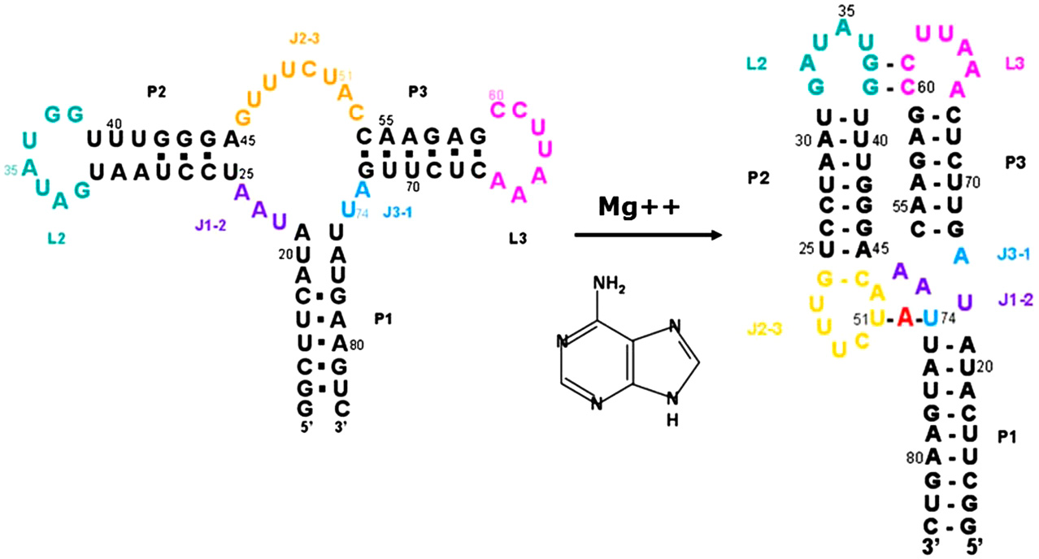
In order to reach the bound form of the riboswitch, MgCl2 was titrated into a solution containing equivalent amounts of nucleotide and RNA, and 2D ¹H, ¹⁵N HSQC spectra were recorded.
Fig. 1. Sequence and secondary structures of the ligand-free and ligand-bound adenine-sensing riboswitch ligand-binding domain of the add A-riboswitch from Vibrio vulnificus. The secondary structure of the free riboswitch is based on NMR data, as well as the assignments reported in this study.

Slide 5
2D ultraSOFAST NMR spectra
Obviously, the application of multidimensional NMR methods would greatly improve our ability to follow these conformational transitions in real time and with atomic resolution, provided fast enough data collection could be achieved.
to follow the complete conformational change from ligand-free to ligand-bound form of the adenine riboswitch
multiple folding intermediates

Slide 6
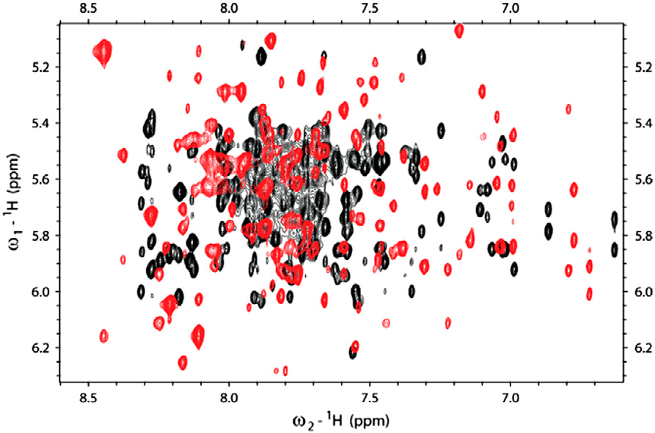
NOESY spectrum
add adenine-sensing riboswitch aptamer domain :
71 nucleotides
The RNA was per-deuterated at the H5, H3′, H4′, and H5′-H5′′ positions, while retaining full protonation at the H6/H8/H2, H1′, and H2′ positions.
severely overlapped and broad, because of the slow tumbling time
Fig. S1. Nonexchangeable proton NOESY spectra of free and bound adenine-sensing riboswitch aptamer domain. Overlay of the base protons to H1′ regions of the partially deuterated RNA in its free form (Black) and bound to adenine (Red) at 298 K.

Slide 7
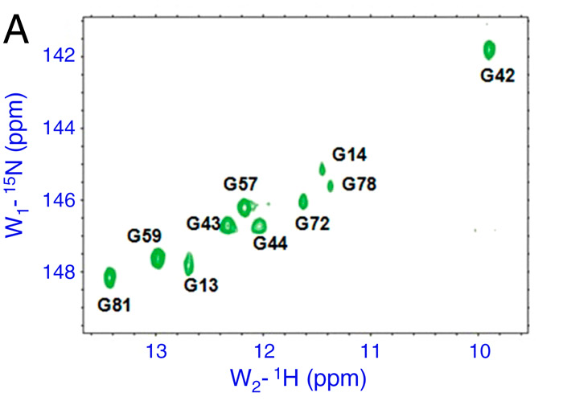
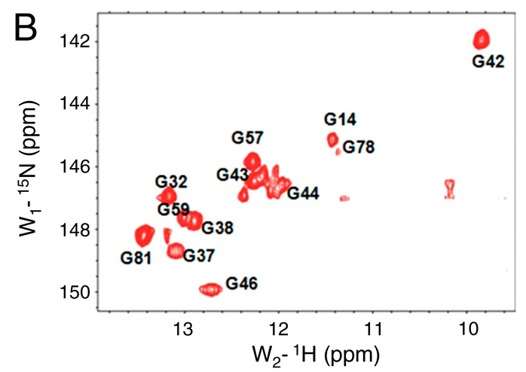
Conventional 1H, 15N-HSQCs of the free 15N-G-labeled RNA
HSQC spectrum
Conventional 1H, 15N-HSQCs of the bound 15N-G-labeled RNA
Fig. 2. Two-dimensional spectra of the ligand-free and ligand-bound adenine-sensing riboswitch aptamer domain.

Slide 8
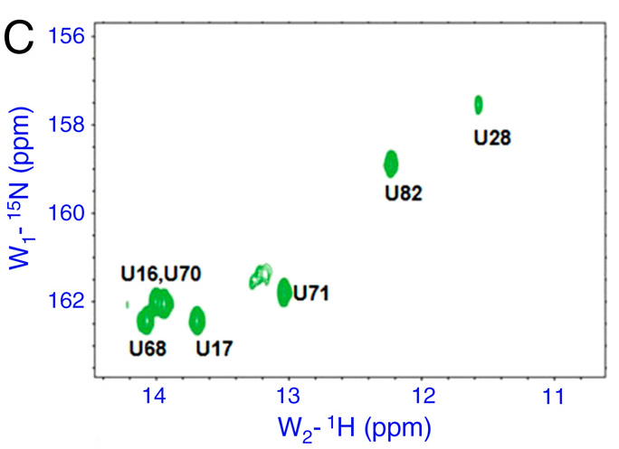
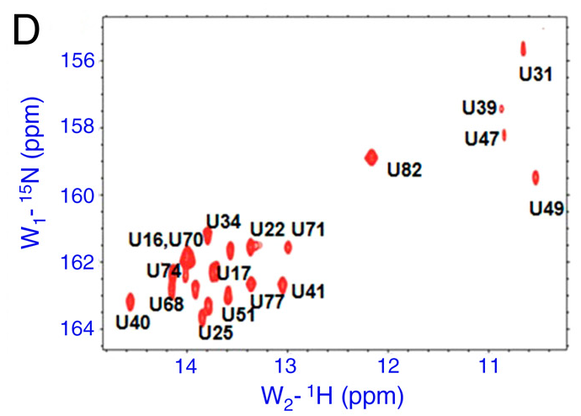
Conventional 1H, 15N-HSQCs of the free 15N-U-labeled RNA
Conventional 1H, 15N-HSQCs of the bound15N-U-labeled RNA
Fig. 2. Two-dimensional spectra of the ligand-free and ligand-bound adenine-sensing riboswitch aptamer domain.

Slide 9
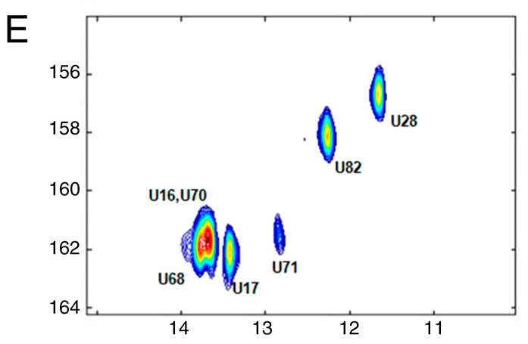
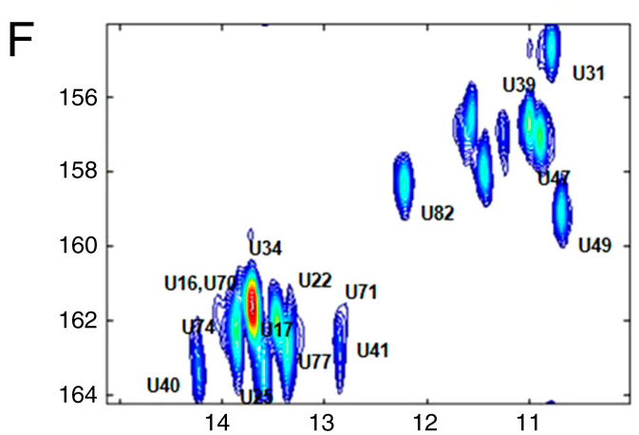
UltraSOFAST 1H,15N correlation spectra of the free 15N-U-labeled RNA
UltraSOFAST 1H,15N correlation spectra of the bound15N-U-labeled RNA
Fig. 2. Two-dimensional spectra of the ligand-free and ligand-bound adenine-sensing riboswitch aptamer domain.

Slide 10
most imino proton peaks in the three helices were observed, indicating that
all helices are stabilized by ligand binding; new imino proton signals corresponding to the three-helix junctions appear as well.
The structure demonstrates that adenine forms a Watson–Crick base pair with U74 and interacts with U47, U51, and U22.
H2O NOESY
adenine–riboswitch complex displayed strong NOEs between the imino protons of U74 and U51 and the H2 of the bound adenine.
The most interesting NMR signals arising from this complex correspond to the imino proton peaks of the G37 and G38 residues.
long-distance base pairs between G37 and C61, as well as G38 and C60
interactions between loops 2 and 3

Slide 11
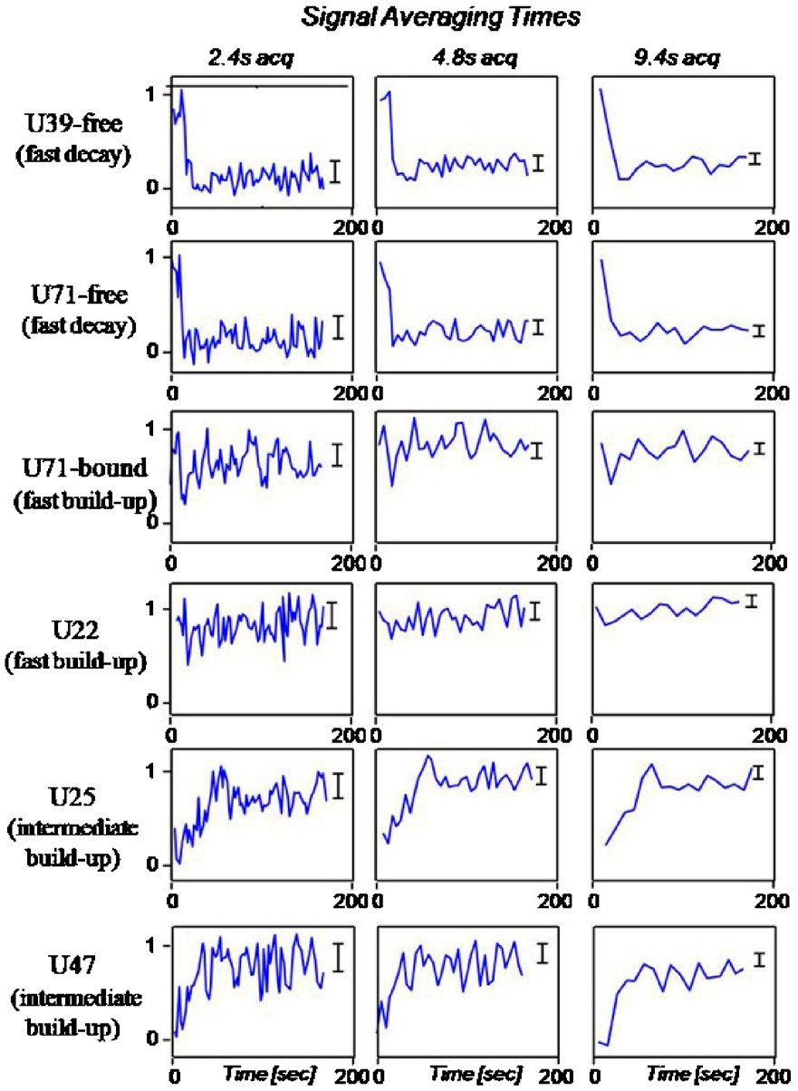
representative changes observed as a function of time from the moment of injection in the real-time 2D NMR experiments for several Uracil bases whose signals changed upon injection of the ligand
Fig. 3. Signal buildup and decay curves for representative sites in the riboswitch

Slide 12
After addition of the ligand by rapid mixing, signals corresponding to the free species decrease, while resonance stemming from the adenine-bound RNA increase over time.
The appearance of a new peak indicates the formation of a new set of hydrogen bonds, stable enough to lead to protection from exchange with solvent.
It is clear that peaks corresponding to the bound state of the RNA arise with different kinetics, that for convenience we classify into “slow”, “intermediate”, and “fast”.

Slide 13
UltraSOFAST HMQCs of the A-Riboswitch Aptamer Domain
ultraSOFAST ¹H, ¹⁵N-HMQCs of [¹⁵N-G]- or [¹⁵N-U]-labeled riboswitches
repetitive 2D NMR acquisition at very fast rates
the ligand was mixed manually outside the magnet with a G-enriched RNA
initial dead time = 16 sec
two representative experiments
a U-enriched sample using rapid injection inside the magnet with data recording already active
initial dead time = 1 sec

Slide 14
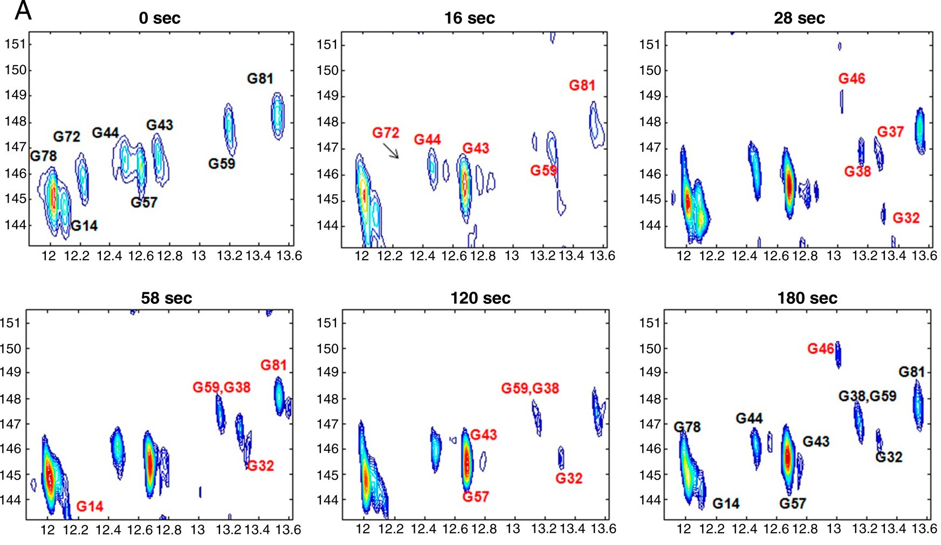
HMQC spectrum
Fig. 4. (A) Representative real-time 2D HMQC NMR spectra recorded at pH 6.1 and 298 K on a ∼1.7 mM ¹⁵N-G-labeled adenine riboswitch ligand-binding domain; the times indicated in each frame correspond to the time point following addition of adenine and Mg²⁺ to the free RNA solution.

Slide 15
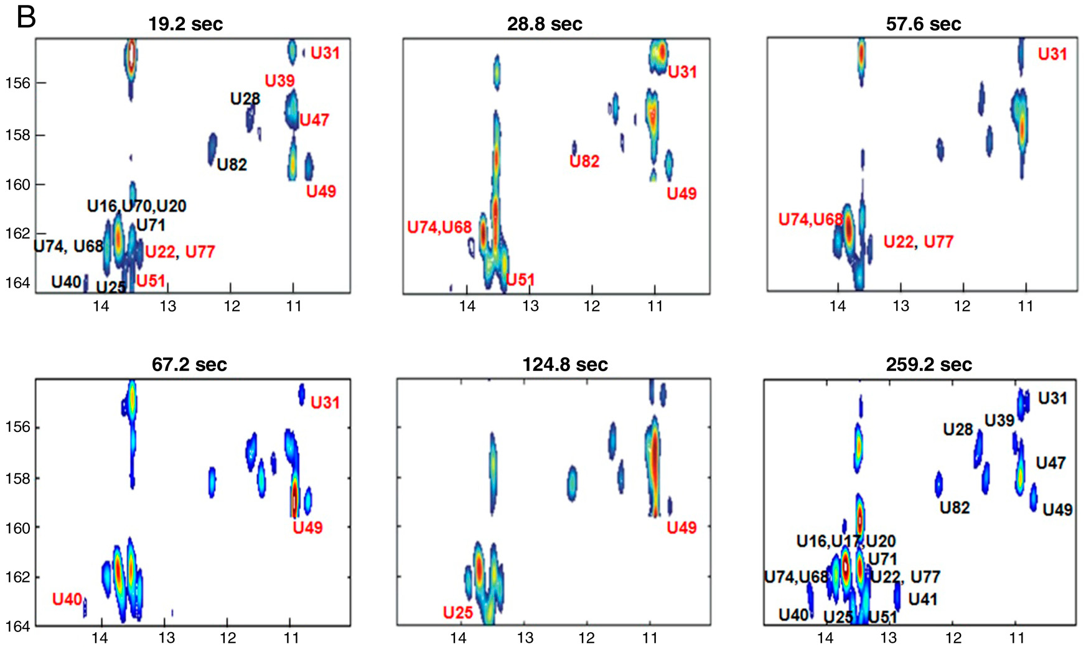
Many new peaks appeared in the shortest spectra recorded on the U-labeled sample, even prior to 10 sec, which could be accessed because of more rapid injection.
Fig. 4. (B) Representative real-time 2D HMQC spectra of the [15N-U]-labeled riboswitch recorded at the indicated times following ligand addition in the magnet by rapid mixing.

Slide 16
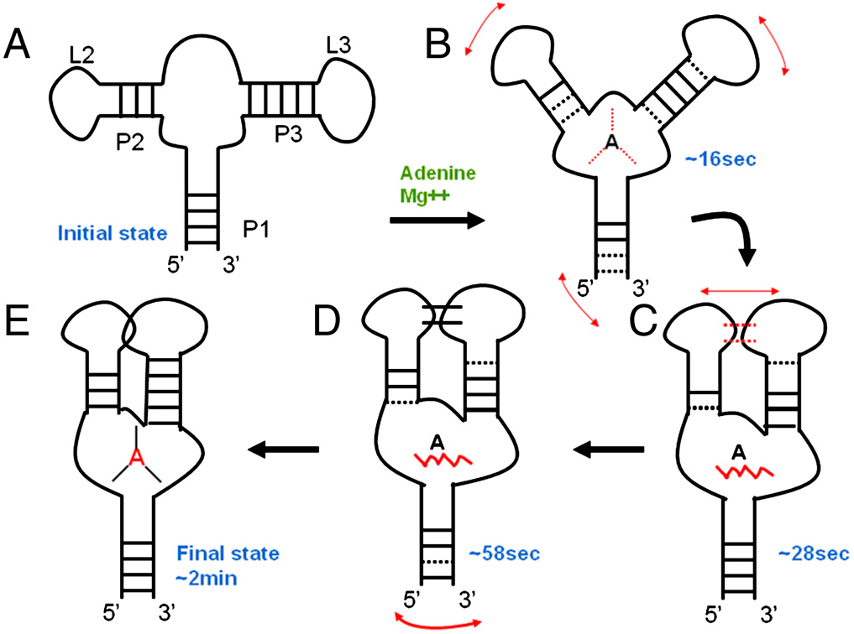
Fig. 5. Secondary structure representation of the ligand-induced folding of the adenine-sensing riboswitch ligand-binding domain, as revealed by realtime 2D NMR.

Slide 17
Thanks

