Slide 1


In the name of GOD
Direct NMR Detection of Alkali Metal Ions Bound to G-Quadruplex DNA
J. AM. CHEM. SOC. 2008, 130, 3590-3602
Zeinab Mokhtari
15-Feb-2011

Slide 2



Queen’s university, Canada, founded in 1841
Ramsey Ida and Gang Wu

Slide 3

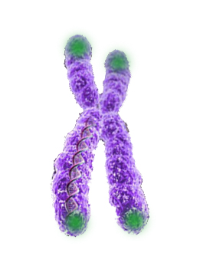
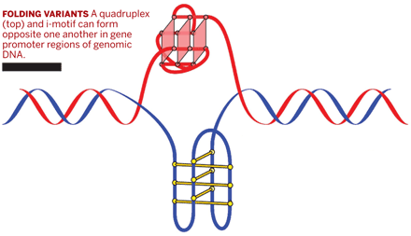

A telomere is a region of repetitive DNA at the end of a chromosome, which protects the end of the chromosome from deterioration. Its name is derived from the Greek nouns telos (τέλος) "end" and merοs (μέρος, root: μερ-) "part". The telomere regions deter the degradation of genes near the ends of chromosomes by allowing for the shortening of chromosome ends, which necessarily occurs during chromosome replication.
Introduction
Telomeres function by preventing chromosomes from losing base pair sequences at their ends. They also stop chromosomes from fusing to each other.
When the telomere becomes too short, the chromosome reaches a "critical length" and can no longer replicate. This means that a cell becomes "old" and dies by a process called apoptosis.
http://en.wikipedia.org/wiki/Telomere
Telomeres do not contain the codes for proteins ➔ are not themselves genes.
Telomere

Slide 4
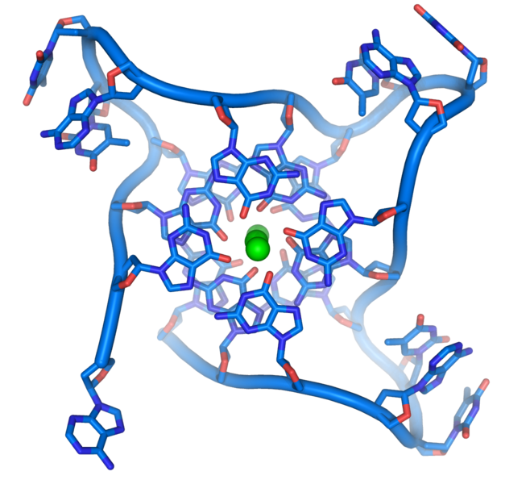
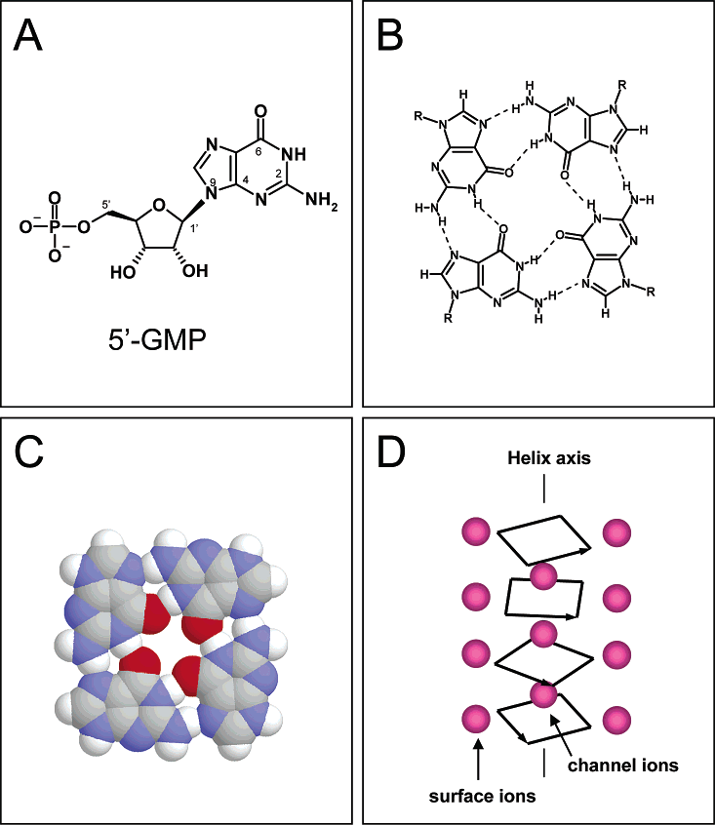
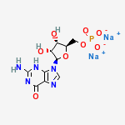
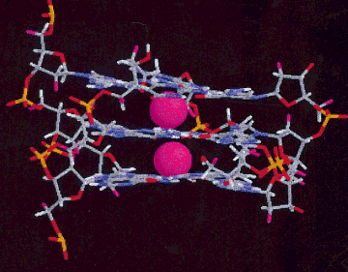
Introduction
J. AM. CHEM. SOC. 2003, 125, 13895-13905
(A) Atomic numbering for 5’-GMP. (B) G-quartet model. (C) Space-filling model of the G-quartet. (D) Diagram showing the two types of cation environments in 5’-GMP.

Slide 5
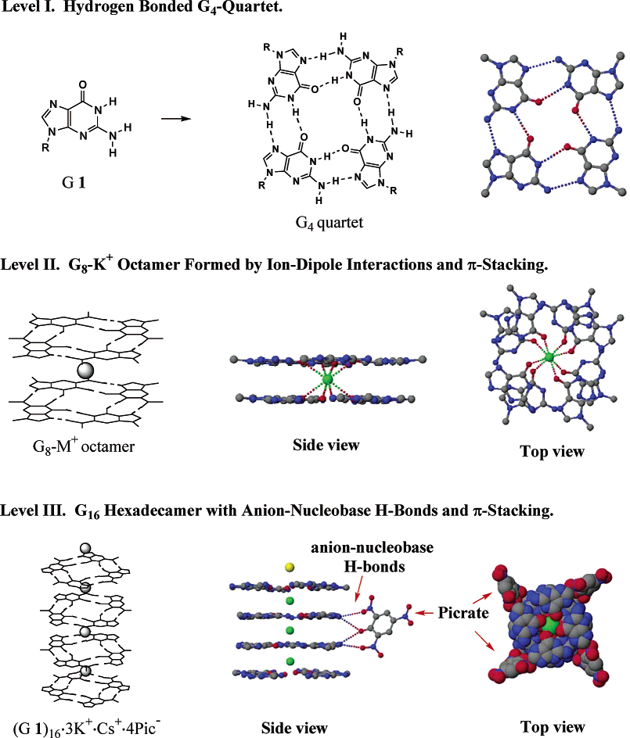
Introduction
J. AM. CHEM. SOC. 2003, 125, 10830-10841

Slide 6
G-quadruplexes characterization
Introduction
solution NMR spectroscopy
or
crystallography

Slide 7
The mode of alkali metal ion binding in G-quadruplex DNA and RNA
Alkali metal ions :
important roles in the formation, stability, and structural polymorphism of G-quadruplex DNA and RNA
Introduction
high-resolution crystallography
and
solid-state NMR
much more difficult in solution

Slide 8
Laszlo and coworkers 1979-1980
the first model for ion binding to a G-quartet structure
solution ²³Na, ³⁹K, and ⁸⁷Rb NMR
Introduction

Slide 9
Relaxation data analysis
Later, Braunlin and co-workers 1993-1996
Solution ²³Na and ³⁹K NMR techniques to directly study ion binding to G-quadruplex DNA.
Introduction
Conclusion : alkali metal ions tightly bound to a G-quadruplex DNA are “invisible” to NMR in solution, because of low signal intensity and unfavorable quadrupole spin relaxation properties.
An indirect approach : NMR relaxation properties of alkali metal ions are measured for the averaged signal and analyzed using either two-site or three-site chemical exchange models.
relaxation data analysis
Only ion binding information for the tightly bound sites

Slide 10
Since the late 1990s
NMR methodologies based on spin-1/2
directly probing NH₄⁺ and Tl⁺ ions in G-quadruplex DNA
new information about NH₄⁺ ion movement inside G-quadruplex channels
Introduction

Slide 11
multinuclear NMR methodology
Ramsey Ida and Gang Wu 2005
Alkali metal ions (Na⁺, K⁺, and Rb⁺) tightly bound to a G-quadruplex structure can be directly observed by ²³Na, ³⁹K, and ⁸⁷Rb NMR even in the liquid state.
Introduction
directly studying alkali metal ion binding to G-quadruplex DNA
d(TG₄T), d(G₄T₃G₄), and d(G₄T₄G₄)

Slide 12
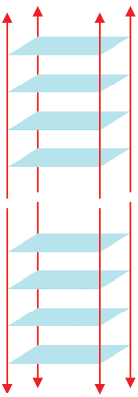
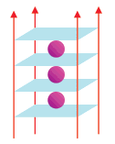
d(TG₄T)
The G-quadruplex structure formed by DNA hexamer d(TG₄T) in the presence of Na⁺ or K⁺ ions
The solution structure :
Four d(TG₄T) strands form a parallel-stranded G-quadruplex structure containing four stacked G-quartets.
only one ²³Na NMR signal at -17 ppm
Introduction
The crystal structure :
Four-stranded parallel structure similar to the solution structure.
A distinct intermolecular stacking (a pair of quadruplex structures that are stacked at the 5’ ends)
A total of seven Na⁺ ions located either between or within the G-quartet planes
crystal packing effect
Solid-state ²³Na NMR :
Na⁺ ions between two adjacent G-quartets (signal centered at -19 ppm)
the illusive signal from the in-plane Na⁺ ions because of the presence of a large signal due to phosphate-bound Na⁺ ions

Slide 13
Whether the mode of Na⁺ ion binding is the same in solution and solid states?
Introduction

Slide 14
Clark et al. 2003
A crystal structure of d(TG₄T) complexed to a drug molecule, daunomycin
Daunomycin prefers to be stacked onto the ends of the G-quadruplex rather than to intercalate between the G-quartet layers.
Na⁺ ions are located only between adjacent G-quartet planes.
Introduction

Slide 15
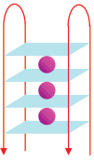
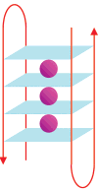
d(G₄T₃G₄)
Neidle and co-workers 2006
The crystal structures of the K⁺ form of d(G₄T₃G₄)
d(G₄T₃G₄) forms a bimolecular intermolecular G-quadruplex with two lateral thymine loops ( either on the same G-quadruplex face, forming a head-to-head dimer, or on the opposite faces, resulting in a head-to-tail dimer).
Introduction
K⁺ ions were found between G-quartets, each being equidistant from eight O₆ guanine atoms.
Not large energy differences between the head-to-head and head-to-tail bimolecular G-quadruplexes containing the T₃ loops
Both of these forms may be present in solution.

Slide 16
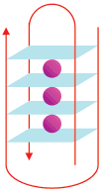
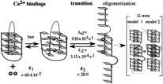
d(G₄T₄G₄)
The bimolecular G-quadruplex structure formed by d(G₄T₄G₄) :
related to the repeat sequence d(T₄G₄) found in the Oxytricha noVa telomere
Solution : an antiparallel, bimolecular quadruplex structure consisting of four stacked G-quartets and two diagonal thymine loops.
Introduction
Feigon and co-workers 1999 , 2003
various ionic forms of d(G₄T₄G₄) in solution
The nature of monovalent cations present in the solution (Na⁺, K⁺ and NH₄⁺) does not affect the overall fold of d(G₄T₄G₄).
In the presence of Ca²⁺, d(G₄T₄G₄) can undergo a structural transition from an antiparallel to a parallel quadruplex, which in turn can aggregate into a large molecular assembly known as the G-wire.

Slide 17
d(G₄T₄G₄)
K⁺
The crystal structure of the K⁺ form of d(G₄T₄G₄)
Very similar to that found in solution
Introduction
Explicit information about the mode of ion binding in d(G₄T₄G₄)
Three K⁺ ions resided inside the quadruplex channel, each being sandwiched between two adjacent G-quartets.
Two additional K+ ions in the thymine loop regions

Slide 18
d(G₄T₄G₄)
Tl⁺
the same structure as the K⁺ form
Interestingly, when an acridine derivative interacts with d(G₄T₄G₄), the drug molecule enters into one of the thymine loop regions, replacing the loop K⁺ ion in the same loop but leaving the other loop K⁺ ion unperturbed.
Introduction
solution ²⁰⁵Tl NMR :
four signals between 80 and 150 ppm
Two of the four ²⁰⁵Tl NMR signals : Tl⁺ ions inside the quadruplex channel in the same coordination environment as those seen for K⁺, NH₄⁺, and Na⁺
The other two signals : Tl⁺ ions residing in the thymine loop region

Slide 19
d(G₄T₄G₄)
NH₄⁺
Three NH₄⁺ ions are located inside the G-quadruplex channel in a way identical to the mode of K⁺ binding observed in the crystal structure.
Introduction
However, no NMR evidence was found for NH₄⁺ ions to be located in the thymine loop region.

Slide 20
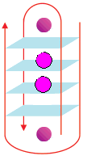
d(G₄T₄G₄)-protein
Na⁺
Crystal structure :
a completely different mode of ion binding
Two Na⁺ ions are located nearly coplanar with the two central G-quartets, and two additional Na⁺ ions are located in the thymine loop regions.
Introduction
Although these crystallographic studies have provided unequivocal evidence about the mode of K⁺, Tl⁺, and Na⁺ ion binding both inside the quadruplex channel and in the thymine loop region, it is far less certain whether the same type of ion binding should occur in solution for the Na⁺ form of d(G₄T₄G₄).

Slide 21
d(G₄T₄G₄)
Na⁺
solid-state ²³Na NMR : three Na⁺ ions reside inside the G-quadruplex channel, each being sandwiched between two adjacent G-quartets
Introduction
Clearly different

Slide 22
The exact mode of Na⁺ ion binding in d(G₄T₄G₄)???
Introduction

Slide 23
d(TG₄T), d(G₄T₃G₄), and d(G₄T₄G₄)
In this study :
Why?
The G-quadruplex structures formed from these DNA oligomers have been fully characterized by either solution NMR or crystallography.
Introduction
They represent three classic types of G-quadruplexes: parallel-stranded, bimolecular with lateral loops, and bimolecular with diagonal loops.
No information is available regarding the mode of Na⁺ ion binding to these G-quadruplexes in solution.

Slide 24

Sample Preparation
DNA oligonucleotides of d(TG₄T), d(G₄T₃G₄), and d(G₄T₄G₄)
Synthesized
Purified
For Na⁺ forms of DNA : Dissolved in deionized water followed by extensive dialysis against NaCl
Lyophilized
For NMR experiments : DNA oligomers were dissolved in sodium phosphate buffer with appropriate amounts of NaCl added.
strand concentrations of the DNA : UV-vis spectrometer
The total Na⁺ ion concentration : NaCl standard and ²³Na NMR
Experimental Details

Slide 25
NMR Experiments
NMR spectrometers
Bruker Avance-400 (9.4 T)
Avance-500 (11.7 T)
Avance-600 (14.1 T)
WATERGATE sequence to suppress the water Signal in ¹H NMR experiments.
The pulse sequence of longitudinal eddy current delay (LED) with bipolar-gradient pulses for H DOSY experiments.
Experimental Details
A 5-mm quartz NMR tube for solution ²³Na NMR experiments, to reduce the ²³Na background signal from regular glass materials.
The 1D ²³Na NMR spectra were acquired using an inversion-recovery sequence with the interpulse delay (recovery delay) set to appropriate values depending on the actual T₁ value for the free ²³Na signal.
1D ⁸⁷Rb NMR spectra : single-pulse sequence
Solid-state ²³Na NMR spectra :
Bruker Avance-II 900 (21.1 T) spectrometer using a 4-mm magic angle spinning (MAS) probe

Slide 26
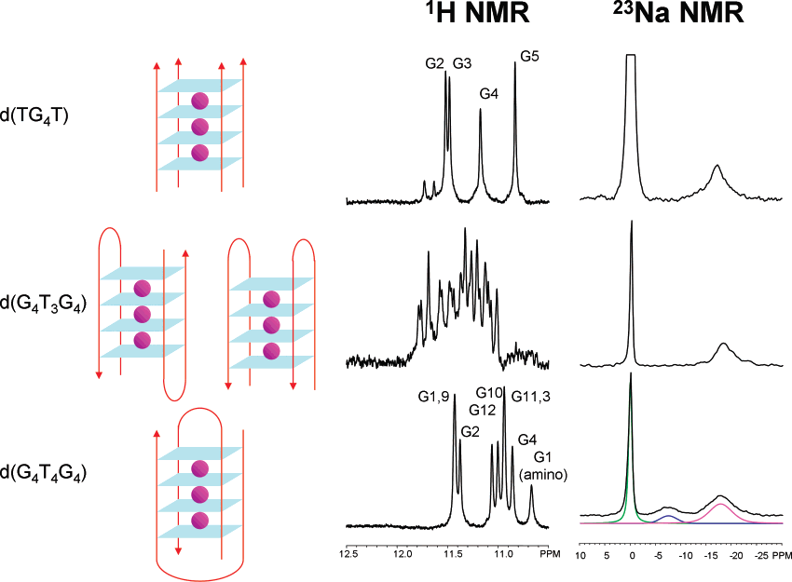
Direct Observation of Na⁺ Ions inside the G-Quadruplex Channel
The large number of imino ¹H NMR signals (ca. 16 peaks) suggests that either d(G₄T₃G₄) forms an asymmetric dimeric G-quadruplex or two dimeric G-quadruplex structures coexist in solution.
As mentioned earlier, the crystallographic study of the K⁺ form of d(G₄T₃G₄) indeed suggests that head-to-tail antiparallel and head-to-head dimers are both possible.
imino ¹H NMR signal confirming the formation of fully folded G-quadruplex
Results and Discussion
a well-defined signal at -17.7 ppm (Na⁺ ions residing inside the G-quadruplex channel being coordinated to eight O₆ guanine atoms)
No solution 1H NMR structure has been reported in the literature.
¹H and ²³Na NMR spectra for the Na⁺ forms of d(TG₄T), d(G₄T₃G₄), and d(G₄T₄G₄)

Slide 27

A general concern regarding ²³Na NMR studies of DNA
It is necessary to employ NMR techniques to suppress the large ²³Na NMR signal arising from free Na⁺ ions, allowing much weaker signals due to DNA-bound Na⁺ ions to be effectively detected.
inversion-recovery pulse sequence
T₁ filter
Results and Discussion
The ²³Na NMR signal at δ= 0 ppm (denoted as the free Na⁺ signal) is actually the averaged signal for Na⁺ ions undergoing fast exchange between a truly free state and a phosphate-bound state.
high-quality ²³Na NMR spectra for DNA
Because the free Na⁺ ions have a much longer spin-lattice relaxation time (typically T₁ ~10 ms) than do the tightly bound Na⁺ ions (typically T₁ < 1 ms), we can set the interpulse delay (recovery delay) to be very close to the so-called null (zero-crossing) point for the free Na⁺ ions so that the signal from the free Na⁺ ions would be greatly reduced, whereas the signals from the bound Na⁺ ions have already fully recovered at this point and thus show their full intensities in the spectra.

Slide 28
Na⁺ ion occupancy inside the G-quadruplex channel
The concentration of Na⁺ ions that give rise to the ²³Na NMR signal at -17.7 ppm in each of the three DNA samples
d(G₄T₃G₄)
d(G₄T₄G₄)
Results and Discussion
three channel sites
straightforward to estimate the ion occupancy
approximately 100%
each G-quadruplex channel contains three Na⁺ ions
d(TG₄T)
two stacking tetramolecular G-quadruplexes related by symmetry not possible to assess with ¹H NMR
complicated
¹H DOSY

Slide 29
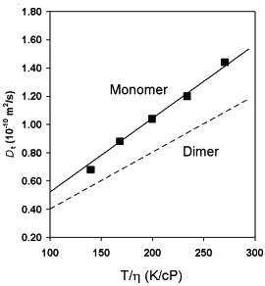
¹H DOSY
molecular translational coefficient (D) of the d(TG₄T) G-quadruplex
combined bead/cylinder model
Not a dimer in the DNA concentrations used in our study
Results and Discussion
the length of the d(TG₄T) G-quadruplex in D₂O:
20 ± 4 Å
half of the length for the G-quadruplex dimer found in the crystal structures
Similar results : 3 ions per G-quadruplex

Slide 30
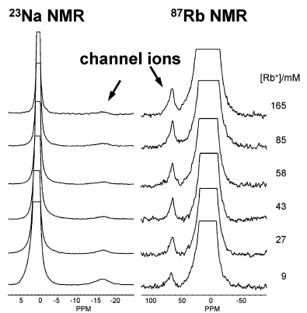
Competitive Binding of Na⁺ and Rb⁺ Ions for the G-Quadruplex Channel Site
well-defined NMR signals for alkali metal ions residing inside the G-quadrupelx channel
d(TG₄T)
possible to study competitive ion binding by simultaneously detecting the two competing metal ions
Results and Discussion
Rb⁺/Na⁺ titration experiment
Rb⁺ ions undergoing fast exchange between free and phosphate-bound states
First time
0 ppm
70 ppm
Two ⁸⁷Rb NMR signals
gradually replacement of the Na⁺ ions
Rb⁺ ions residing inside the G-quadruplex channel

Slide 31


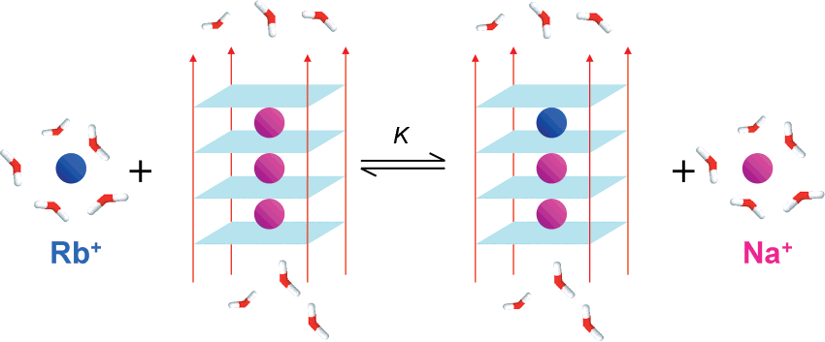
Results and Discussion
d(TG₄T)
Illustration of the competitive Rb⁺/Na⁺ ion binding for the channel site of d(TG₄T) G-quadruplex

Slide 32


Confirmed by
¹H NMR data
Assuming full ion occupancy inside the channel and no DNA unfolding during the Rb⁺/Na⁺ titration experiment:
Results and Discussion
Rb+ ions residing inside the channel:
fit the curve of [Rb+]_{channel} versus [Rb+]_{total}
K

Slide 33
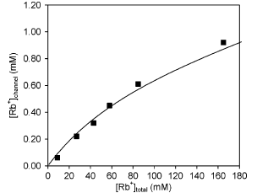
K=1.6±0.2 at 298 K for the Rb⁺/Na⁺ competition for the G-quadruplex channel site
Results and Discussion
Rb⁺ ions are preferred over Na⁺.
This value of K is also in agreement with that reported by Wong and Wu for 5’-GMP, K=1.8 at 298 K, on the basis of a solid-state NMR titration experiment.
J. AM. CHEM. SOC. 2003, 125, 13895-13905
a valid approach for obtaining solution properties
The Na⁺ ion at the channel site is fully dehydrated ➔
no difference between measurements in solution or solid state

Slide 34
5’-GMP
two separate ²³Na NMR signals :
-17.0 ppm : Na⁺ ions inside a G-quadruplex filled with Na⁺ ions
-16.2 ppm : Na⁺ ions in a channel containing mixed Rb⁺/Na⁺ ions
Results and Discussion
channel Na⁺ ion signal for d(TG₄T) is much broader
Not observation of resolved ²³Na NMR signals for the channel Na⁺ ions
The situation is different in the K⁺/Na⁺ titration experiment.

Slide 35
Residence time of Na+ ions inside the channel
The frequency separation between the two ⁸⁷Rb NMR signals (9.2 kHz at 9.4 T) also allows us to conclude that the residence time of Rb⁺ ions inside the G-quadruplex channel must be much longer than 17 is at 298 K.
Halle and co-workers demonstrated a magnetic relaxation dispersion (MRD) NMR approach to study competitive Rb⁺ and Na⁺ binding to the minor groove of a B-DNAduplex, [d(CGCGAATTCGCG)]2
Results and Discussion
Weak ion binding ➔ mean residence time for Rb⁺ = 0.2 μs
for Na⁺ =10 ns to 100 μs
Much shorter than those estimated for the Na⁺ and Rb⁺ ions residing inside a G-quadruplex channel
Averaged NMR signal was in ²³Na and ⁸⁷Rb NMR spectra of the B-DNA duplex
Direct NMR + MRD

Slide 36
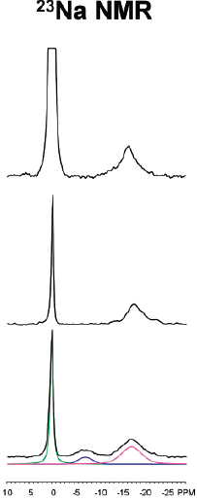
Observation of Na⁺ Ions in the T₄ Loop Region of d(G₄T₄G₄)
Results and Discussion
Four regions for ion binding in G-quadruplex structure:
Phosphate
Groove
Loop
Channel
Na⁺ ions residing in the diagonal T₄ loop regions
(at -7.4 ppm)

Slide 37
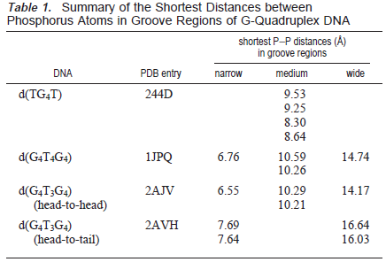
groove width : closest distance between two phosphate oxygen atoms across the groove
Groove Regions
Results and Discussion

Slide 38
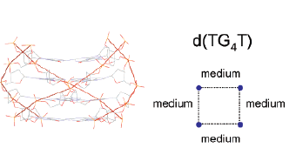
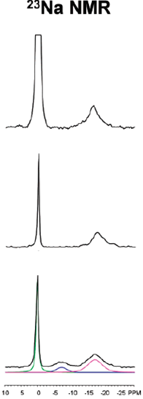
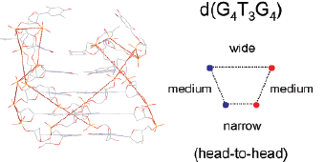
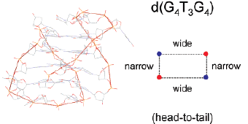
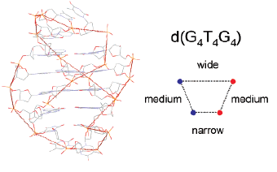
groove width : closest distance between two phosphate oxygen atoms across the groove
Groove Regions
parallel-stranded
All glycosidic bonds of the guanine bases are in anti conformation, resulting in the formation of four equally wide groove regions.
8.30 and 9.53 Å
Cross-phosphate ion binding
syn-syn-anti-anti pattern in glycosidic torsion angles within each G-quartet + diagonal topology ➔ three groove regions
One narrow groove (6.76 Å)
Two medium grooves (10.59 and 10.26Å)
One wide groove (14.74 Å)
Na⁺ ions residing in the diagonal T₄ loop regions

Slide 39
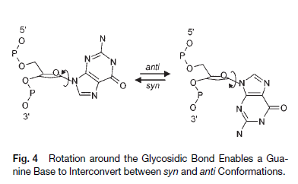
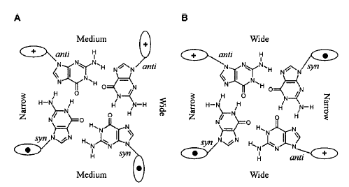
Syn and anti conformations of guanine
Biol. Chem., Vol. 382, pp. 621 – 628, April 2001

Slide 40
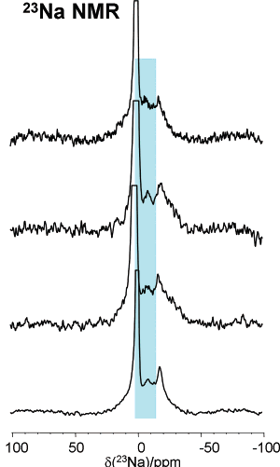
Addition of Mg²⁺ ions to the Na⁺ form of d(G₄T₄G₄)
more strongly interaction with the DNA phosphates but no entering in the G-quadrupelx channel
Decreases of the line width of the ²³Na signal at 0 ppm, free and phosphate-bound states, from 190 Hz before the titration experiment to 46 Hz when the concentration of Mg²⁺ ions reaches 4.7 mM.
Results and Discussion
drastic line-width reduction
Mg²⁺ ions compete very effectively only for the DNA phosphate backbone.
K⁺ ions are capable of competing for all three sites.
-7.4 and -17.7 ppm unchanged

Slide 41
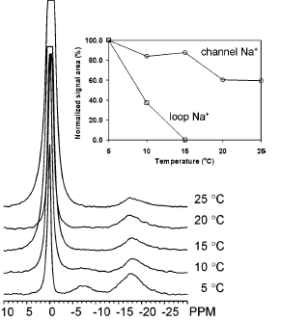
Na⁺ Ions in the T₄ Loop Are Less Tightly Bound Than the Channel Ions.
The loop Na⁺ ions are less tightly bound (or more mobile) than the channel Na⁺ ions, and thus they undergo a much faster exchange between the bound and free states.
Results and Discussion
For the channel Na⁺ ions, the fact that the ²³Na NMR line width shows very little temperature dependence suggests a much longer residence lifetime.
Figure 11. Variable-temperature ²³Na NMR spectra of d(G₄T₄G₄) (5.4 mM strand concentration and [Na⁺]_{total} =70 mM).

Slide 42
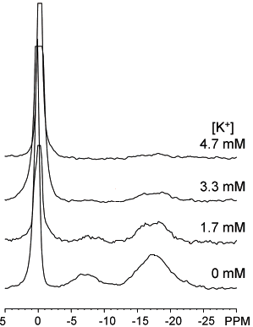
K⁺ Ions Compete for Both Loop and Channel Sites of d(G₄T₄G₄).
K⁺/Na⁺ ion titration
When K⁺ ions are added to the DNA solution, they would replace the Na⁺ ions already bound to the quadruplex channel sites.
Results and Discussion
The loop binding site also exhibits a higher affinity for K⁺ ions than for Na⁺ ions.
²³Na NMR spectra of d(G₄T₄G₄) from a K⁺/Na⁺ ion titration experiment

Slide 43
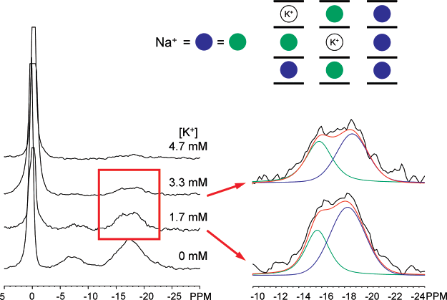
Direct ²³Na NMR Evidence for a G-Quadruplex Channel Filled with Mixed Na⁺ and K⁺ Ions
Type III : channel Na+ ion that resides at the inner site with two K+ ions occupying the two outer sites; with low concentration because of [K+]<<[Na+]
Type II channel Na+ ion : the Na+ ion residing inside the quadruplex channel but having a K+ ion at the nearest binding site
Results and Discussion

Slide 44
previous studies of G-quadruplex channel with mixed ions
X-ray crystallographic or solution ¹H and ¹⁵NH₄⁺ NMR data
Caceres et al. : two crystal structures for d(TG₄T) with mixed Tl⁺ and Na⁺ ions
Neidle and coworkers : mixed Ca²⁺ and Na⁺ ions in the d(TG₄T) quadruplex
Results and Discussion
Sundaralingam and co-workers : mixed Ba²⁺ and Na⁺ ions in a RNA quadruplex formed by (BrdU)r- (GAGGU).
Plavec and co-workers : ¹H NMR evidence for the presence of mixed NH₄⁺ and K⁺ (or Na⁺) ions in d(G₃T₄G₄).
solution ²³Na NMR
Mixed ion information
Remarkable sensitivity of the 23Na NMR chemical shift to subtle difference in ion coordination environment

Slide 45
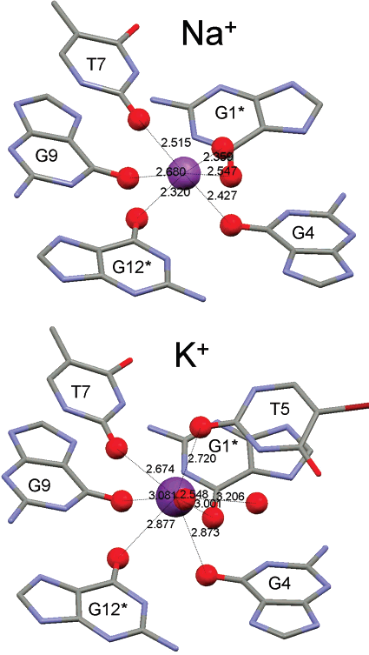
A Hypothesis on Monovalent Cation Binding in Diagonal T4 Loops
The loop ion is located above the terminal G-quartet plane, coordinating to four O6 atoms from the terminal G-quartet, two O2 atoms from the loop thymine bases (T5 and T7), and two water molecules in a square anti-prism geometry.
Results and Discussion
K⁺_O distances considerably longer than the corresponding Na⁺_O values
Molecular model of the Na⁺ & K⁺ ion binding site in the T₄ loop of d(G₄T₄G₄)

Slide 46
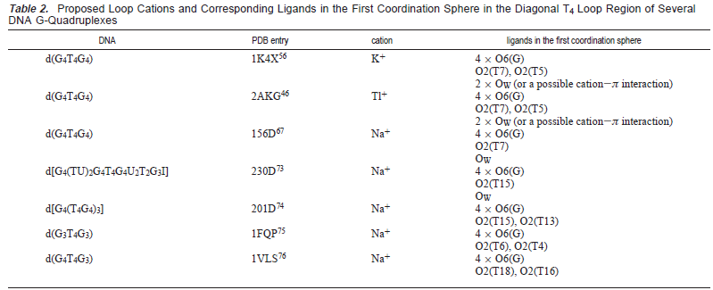

Slide 47
Conclusion
Na+ and Rb+ ions residing inside G-quadruplex channel are “NMR visible” in solution.
Competitive ion binding to a particular site in DNA can be directly monitored by simultaneous NMR detection of the two competing metal ions.
Monovalent cation binding to the diagonal T4 loop of a G-quadruplex may be a general phenomenon.
Solution multinuclear NMR of alkali metals is a viable technique for studying alkali metal ion binding to DNA.

Slide 48

Thanks

